Slide 1
Build your own AST in PowerShell
Chris Gardner

Slide 2
$Env:USERNAME = Chris Gardner
PowerShell user for ~6 years
Too many side projects
Work a lot with Azure and DSC
I have stickers for anyone who wants some
Join Slack/Discord: aka.ms/psslack or aka.ms/psdiscord
@HalbaradKenafin

Slide 3
Agenda
What is an Abstract Syntax Tree (AST)?
The PowerShell AST
How do we make our own AST?
How do we use our AST?
What do we do next?
@HalbaradKenafin

Slide 4
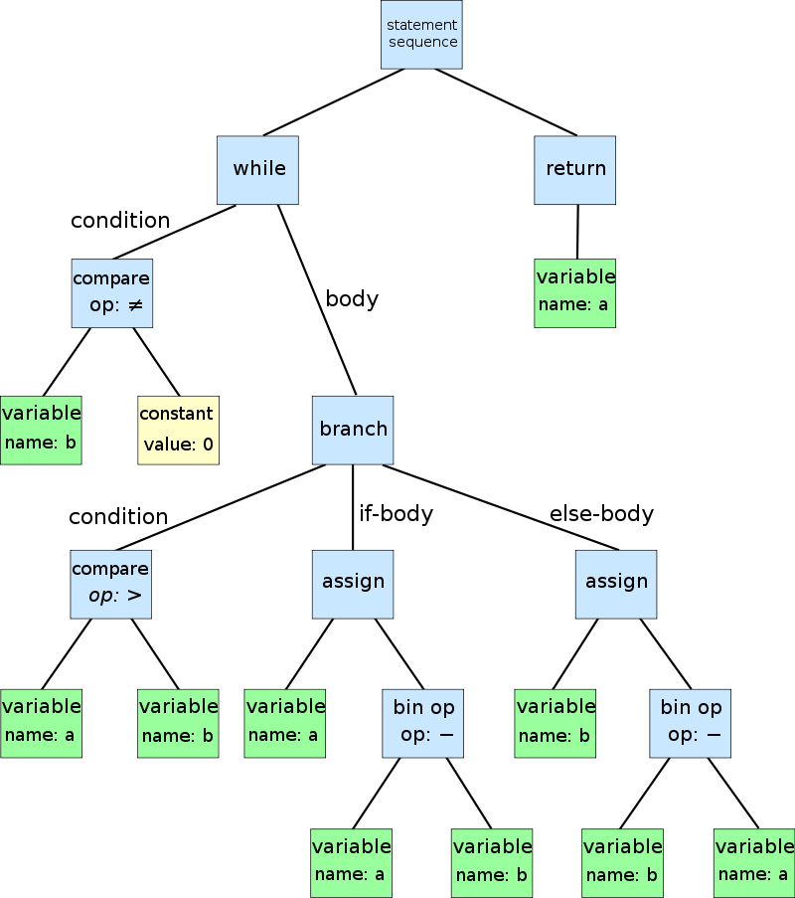
What is an Abstract Syntax Tree?
A tree representation of the abstract syntactic structure of source code written in a programming language.
Each node is a construct in the code, e.g. command, parameter, if statement, pipeline.
Punctuation is rarely part of an AST as it usually isn’t relevant.
@HalbaradKenafin
@HalbaradKenafin
Source: https://en.wikipedia.org/wiki/Abstract_syntax_tree#/media/File:Abstract_syntax_tree_for_Euclidean_algorithm.svg

Slide 5
Components of a PowerShell AST Node
Type – All inherit from S.M.A.Language.Ast, currently 72 in PS 5.1, 71 in 6.x, 72 in 7-preview4
Parent – The important part for making the “Tree” of AST
Extent – Contains the text of the command etc and extra information.
Find()/FindAll() – Extremely useful methods for searching the tree for nodes
SafeGetValue() – Returns the value of a node without executing it
@HalbaradKenafin
Notes:
Interestingly the missing on in 6.x+ is ExtendedMemberExpressionAst, the new on in 7+ is TernaryExpressionAst

Slide 6
Exploring the PowerShell AST
ShowPSAst
EditorAstProvider
AstHelper
https://www.youtube.com/watch?v=ie9FnsgIEO8
@HalbaradKenafin

Slide 7
Demo
@HalbaradKenafin

Slide 8
How do we make our own AST?
Classes, lots of classes – One per node type in your input language
Tests, lots of tests – Need to prove that object you get out looks like what you think it should.
Use existing ASTs as an example
You’ll probably need a parser too – I borrowed/rewrote an existing one.
@HalbaradKenafin

Slide 9
How do we use our new AST?
It Depends
I wanted to validate ARM templates in a better way.
Linting and static analysis of code, such ScriptAnalyzer
@HalbaradKenafin
Notes:
Existing validation of ARM templates is a bit mixed and has various issues in places.

Slide 10
About ARM Templates
Declarative syntax used for deploying Azure infrastructure, written in JSON(-ish).
Schema is well documented and doesn’t change often
5 core components that are standard across all ARM templates

Slide 11
About ARM Templates
Resources – The things which actually get deployed
Parameters – The values you pass in when deploying the template
Variables – The values calculated within the template, sometimes using user input
Outputs – The values passed out of a template for use elsewhere
Functions – Custom functions you can write to use in your templates
Notes:
Resources – Storage accounts, VMs, other Azure stuff. Required for a valid template.
Parameters – names, locations, passwords, anything that can change per deployment.
Variables – doing stuff with user input usually or a value that might want to be used in multiple places
Outputs – generated URLs, references to internal values, other such stuff. For use in other nested templates or the rest of the pipeline
Functions – Useful for ensuring a common format for generated names, some restrictions on what you can use inside it.

Slide 12
Demo
@HalbaradKenafin

Slide 13
Lessons Learned?
It’s bloody difficult
If you’re lucky to be parsing a file that’s a standard format that PowerShell supports then you’ll avoid a bunch of issues
Drawing out the elements of your AST first before writing any code is very helpful

Slide 14
Lessons Learned?
Tests are really helpful, especially when you’re making adjustments later on and hoping your don’t break current functionality.
Rewriting the VS Code extension parser helped a lot but presented some of it’s own challenges, like figuring out what typescript was actually doing.
It’s really bloody difficult, edge cases galore.

Slide 15
What do we do next?
¯\_(ツ)_/¯
Add documentation, examples, more tests (use the examples in your tests)
Make some tools that build on what you’ve built
@HalbaradKenafin

Slide 17
Slides and stuff
Slides on Github: github.com/chrislgardner/presentations
ArmTemplateValidation: github.com/chrislgardner/ArmTemplateValidation
Twitter: @halbaradkenafin
Slack/Discord: @halbarad
@HalbaradKenafin

